Slide 1


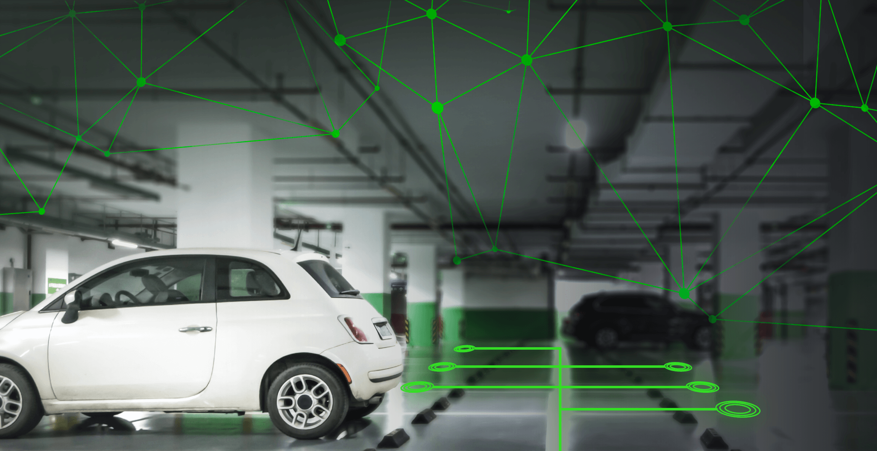
COMPUTER SCIENCE AND ENGINEERING
:
PROJECT TITLE
01
SMART PARKING
SYSTEM USING IOT
A.WAZIL 913021104042
A.REVATHI 913021104025
R.THIRUMAGAL 913021104036
R.NIVETHITHA 913021104018

Slide 2


❖ Introduction
➢ A smart parking system is used to automatically identify vacant & occupied parking slots, without the need to find them manually.
02
➢ The status of the parking slots is detected by the IoT sensors, then their data is transferred to the database to store.
➢ The system allows capturing the exact date and time of entry & exit
of the cars in the parking area.
➢ Depending on the total parking time of the car, the system will intelligently calculate the fare & charge the car owner accordingly.
➢ The car owner can make payment while exiting the parking.

Slide 3
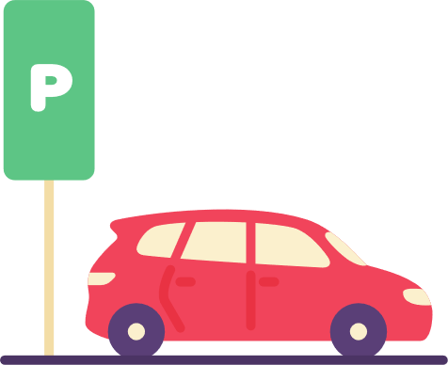
❖ The Need for Smart Parking
➢ In recent years, the number of car owners has been increasing day by day. Hence it becomes very difficult for car owners to find safe parking slot to park their cars.
03
➢ The main problem is finding a parking slot, whether in the shopping mall or at the airport. On average, people spent about 10 to 15 minutes finding suitable parking for their car.
➢ Most people park their cars in places that are not designated for parking, and even in places that are not reserved for parking as well.
➢ This results in car towing and an excessive amount of traffic.
Drives looking for parking space are a major cause of traffic congestion.

Slide 4

❖ Hardware & Software Requirements
➢ Hardware:
• Raspberry Pi
• IR Sensors
• Servo motor
• LCD Display
04
➢ Software:
• Python Programming Language
• React JS
• Tornado Framework
• MySQL Database

Slide 5

❖ Working
➢ First, when a vehicle arrives, it will get detected by an IR sensor.
05
➢ Then, it will check for any vacant slots; if there is any slot available, the gate will open otherwise the gate will not open.
➢ The car will be safely parked in the parking area. this event will also get detected by another IR sensor. It will add an entry to the database and start the timer for that slot & show on LCD display.
➢ When the car exits, we detect it again and stop the timer. & according to parking time, we calculate the fare and charge the car owner

Slide 6

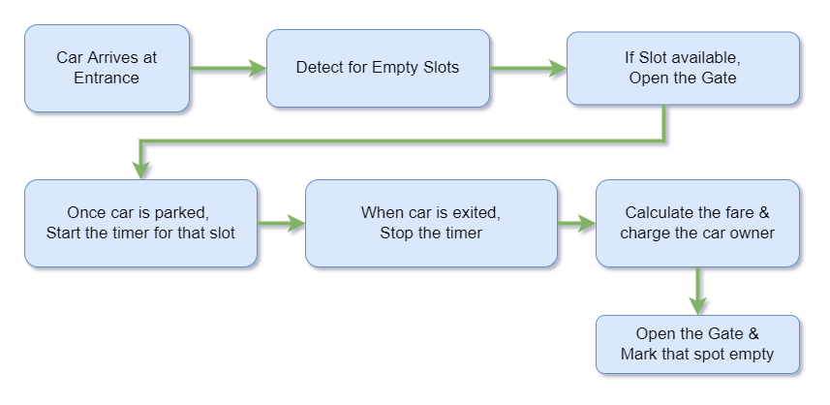
❖ Block Diagram
06

Slide 7
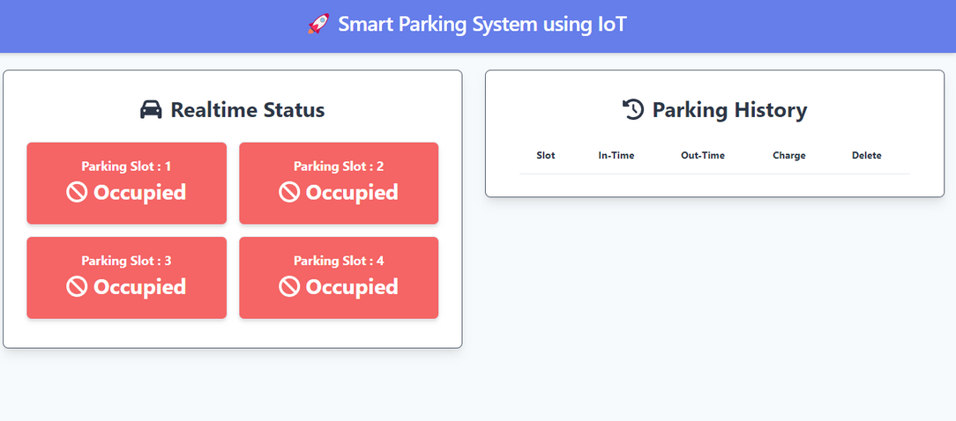

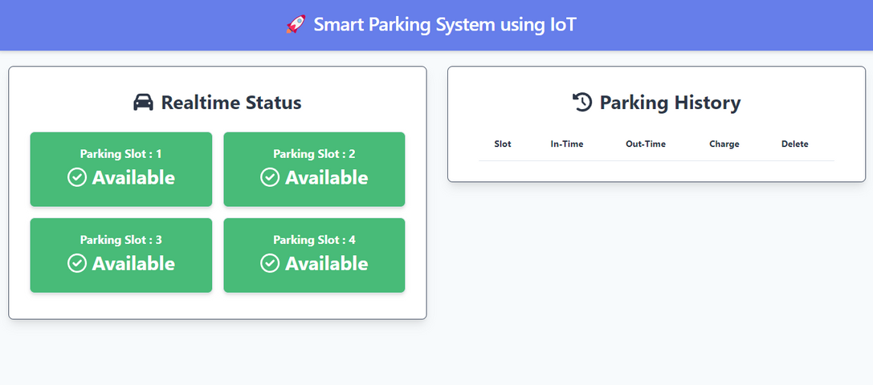
❖ Screenshots
07

Slide 8
❖ Results
➢ Limitations
- The IR Sensors have a short range for detecting the vehicle, so it could be a problem if the vehicle is not parked properly.
- The cost of installation of the system is higher and it increases proportionally by parking space, i.e. more the parking space, higher the cost.
➢ Future Scope
- It could be useful to add a camera and detect the number plates of the vehicle as well for security purposes.
- We can also add payment gateway like PhonePe, GPay, and Paytm. So,
car owners can pay online according to their convenience, without any hassle.
08

Slide 9
09
THANK YOU

